Slide 1
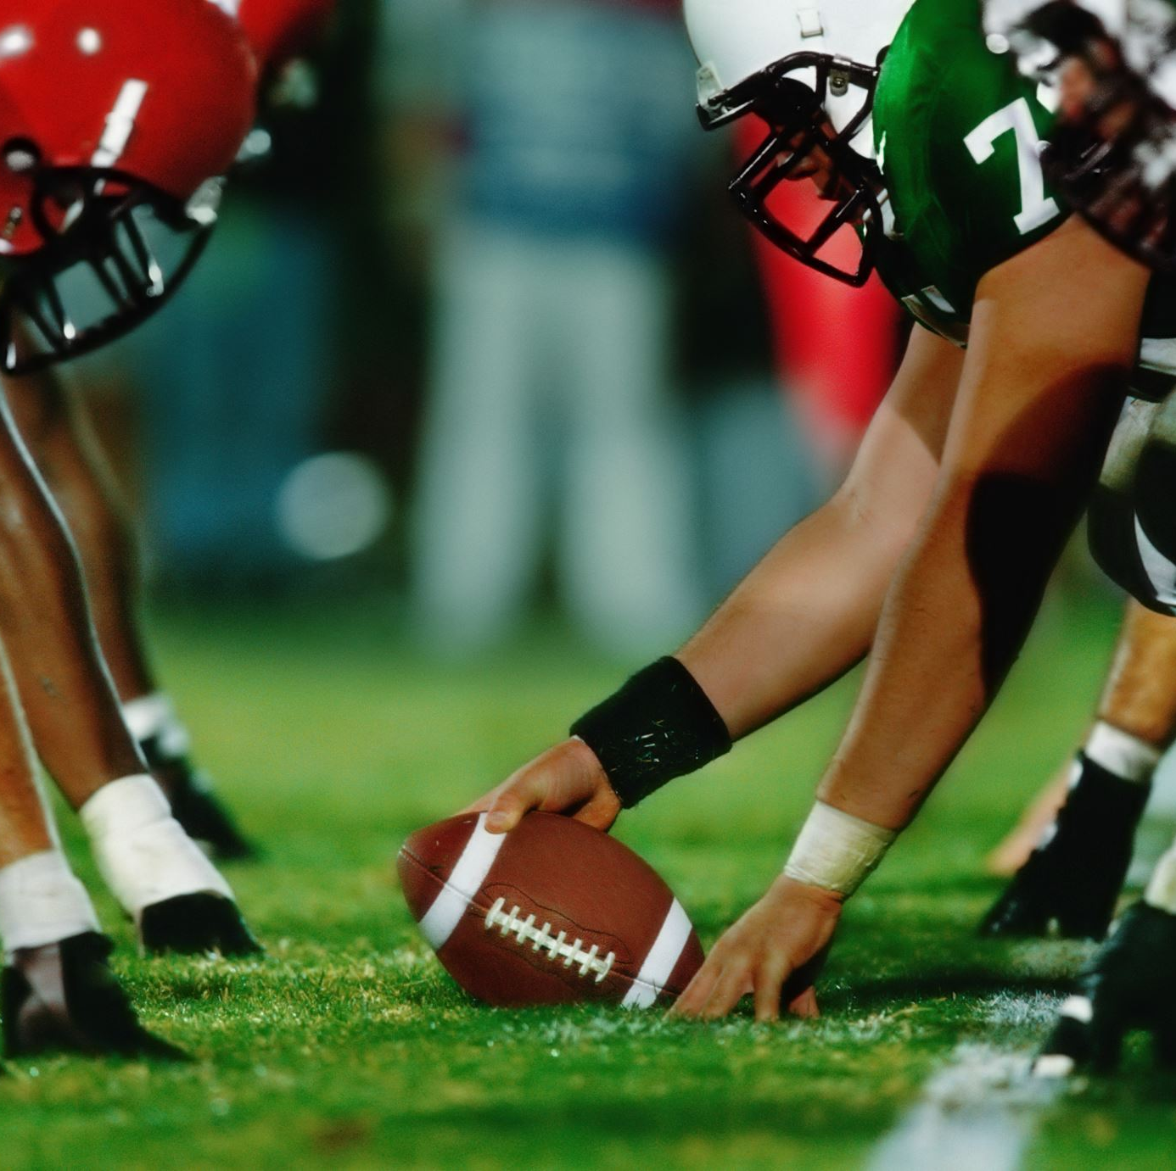
MIS 548
NFL Play-By-Play Analysis
Presented By: Pooja Veenu, Sean Valerga, Siddarth Gopalakrishnan, Xiao Liang, and Zach Newland

Slide 2
Agenda
Dataset Overview
Quality of data and observed issues
Business Objective
Trends among players and characteristics to support draft analysis
Data Cleaning Process
Transformation, missing variable adjustments, and integration of datasets.
Variables created.
Attribute and Column selection.
Research Questions
Insights Provided Among Data
NFL Tenured Players Among Colleges
Common Players in NFL
Exploratory Analysis
Logistic Regression
Linear Regression
Closing Remarks

Slide 3
Organization Members
Group Leader – Zach Newland
Project Manager – Xiao Liang
Business Analyst – Siddarth Gopalakrishnan
Data Engineer – Pooja Veenu
Marketer – Sean Valerga

Slide 4
Dataset Overview
Dataset: NFL play-by-play
Three tables:
Players: (56175, 22)
Plays: (943091, 29)
Teams: (669, 8)
Primary Keys:
'Player_ID','game_year','gsisId','season’, and ‘teamId’
Merged Final data frame:
(528025,34)

Slide 5

Business Objective
Analyze trends in long-term players registered in NFL
Support draft selections for general managers.
Best long-term investment for selection based on position.
Analyze highest drafted schools to support player selection.
Predictive Models:
Logistic Regression: Predict likelihood of on field success and touchdowns
Linear Regression: Predict yards gained that resulted in touchdown.

Slide 6

Data Cleaning
Standard Cleaning:
Verifying duplicates / dropping.
Filling NA values with average among column.
Adding binary variables to columns based on outcome.
Subset of data based on conditions.
Merging string variables.
Selection of rows to reduce data evaluated.
Variable Creation:
Unique Player ID
Player Full Name

Slide 7
Variables Created
Players Dataset:
Player names separated against individual first, middle, and last name.
Combined for "full-name" column to allow merging
Convert height string to numeric variable:
Originally string variable for height in feet and inches. Converted to centimeters.
Teams Dataset:
Adjustment of name column "full_name" to "city_state_name" for diversified columns among datasets.
Plays Dataset:
Player_IDs across plays on various columns based on position type.
Filled new column "Player_ID" which backfilled the player involved in play.
Dropped other various player_ID columns to merge.

Slide 8

Attribute and Column Selection
Players Dataset:
Dropped Columns:
'suffix', 'headshot_url','profile_url','jerseyNumber'
'firstName', 'middleName','lastName','displayName'
Variable Selection:
"ACT" only players
Teams Dataset:
Dropped Columns: 'cityState', 'nick'
Plays Dataset:
Dropped all but 18 columns to support analysis.

Slide 9

Research Questions
Who are the most common players among the NFL over the years?
What makes them unique?
Which Colleges are best represented in the NFL long-term?
Support analysis of best schools to select during NFL Draft.
Can we predict an outcome of success based on play data over the years?
What is the accuracy of this model?
Which are the most important features from this model?

Slide 10
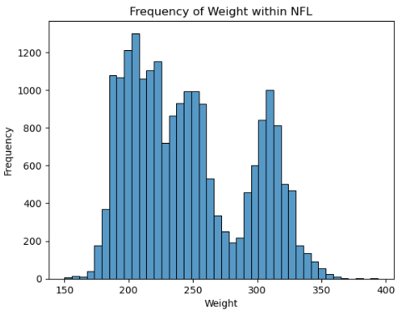
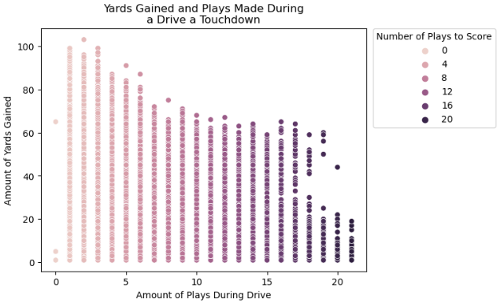
Insights From Data
Frequency of Weight:
Observed among "ACT" players
Three unique peaks found within data.
200 lbs.
250 lbs.
310 lbs.
Skewed to the left.
Yards Gained During Touchdown Play
Negatively correlated:
Amount of plays increases.
As yards gained decreases.
T

Slide 11
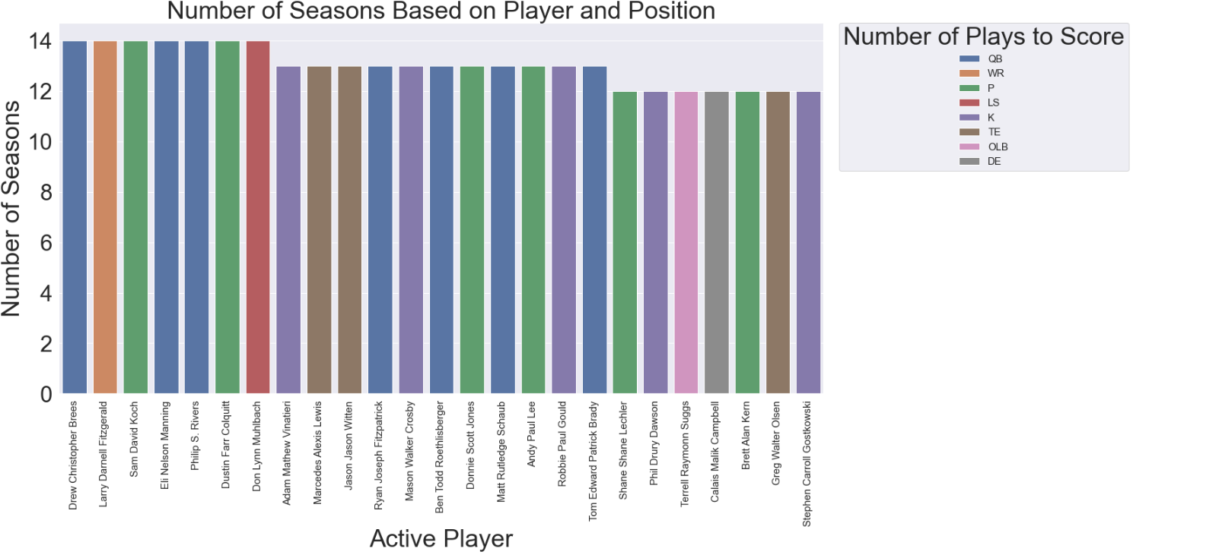
Most Common Positions Among Tenured Players
Most Common Position in NFL Top 25 Longest Tenured Player.
7 QBs
6 Punters
5 Kickers
3 TEs
1 WR
1 LS
1 OLB
1 DE

Slide 12
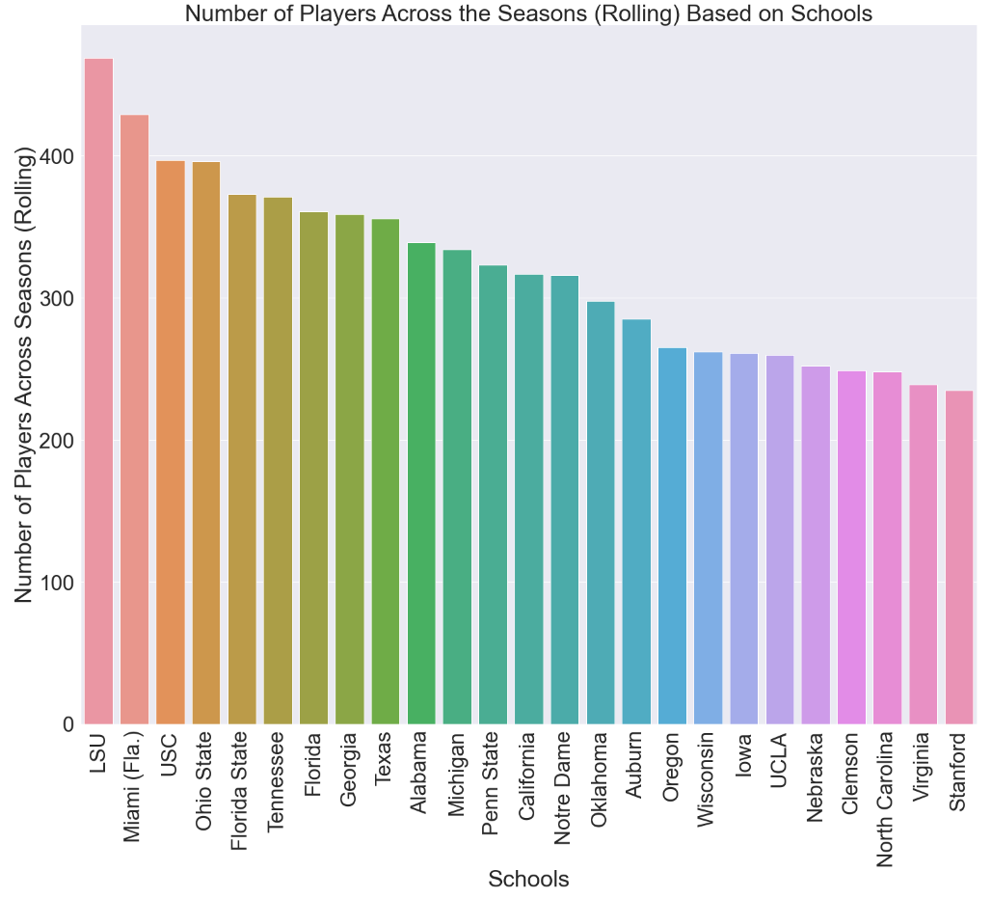
Most Frequent Colleges Among NFL Tenured Players
Top 25 college football teams to develop NFL talent:
6 SEC schools
5 in Top 10.
5 ACC Schools
2 in Top 10.
5 Big 10 Schools
1 in Top 10.
5 PAC12 Schools
1 in Top 10.
2 BIG12 Schools
1 in Top 10.
1 Independent School

Slide 13
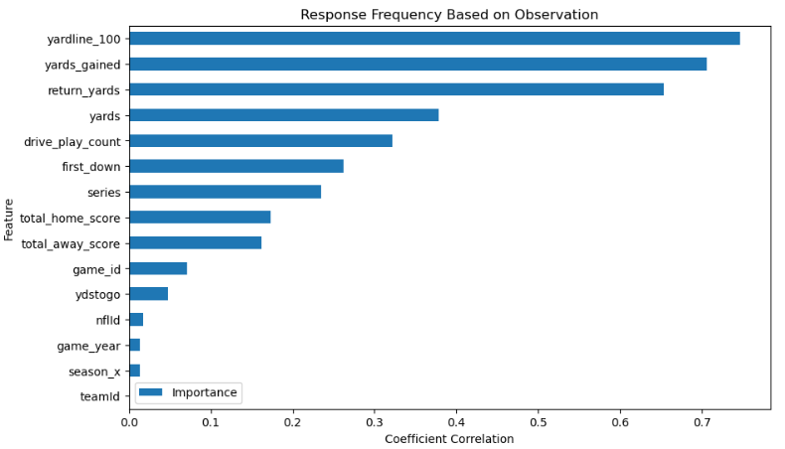
Logistic Regression
Prediction of touchdown outcome:
Touchdown = 1
No touchdown = 0
Sample set of 5,000 observations among final merged dataset
The greatest coefficient in correlation includes:
Yard Line Position of ball placement
Yards gained during plays
Amount of return yards
Yards
Drive play count
Model holds an 78% accuracy in test prediction after train/test split 60/40.
Strong model for likelihood of success outcome.

Slide 14
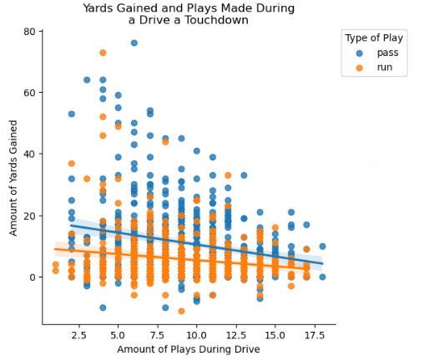
Linear Regression
Sample set of 5,000 observations against final dataset.
Reduced to pass and run plays that resulted in touchdowns.
Slight class imbalance:
619 pass plays
457 run plays
Best fit line indicates steeper slope among pass plays after play drives increase.
Yards gained overall larger among pass plays than run plays among intercept.
Pass plays higher clustering among of yards gained compared to run plays.

Slide 15

Closing Remarks
QB, Punters, and Kickers indicated as longest tenured players in NFL based on years.
Top conference to recruit actively during draft selection is the SEC (5 teams in Top 10 tenured players)
Logistic Regression:
Yard line placement, yards gained, and amount of yard returns plays significantly in likelihood for a touchdown outcome.
Linear Regression:
Overall, greater chance of gaining yards during passing plays.
However, less yards gained after play drives increase.

